Slide 1


CONSULTANCY MANAGEMENT SYSTEM
ADVANCE DATABASE DESIGN
FAB-5
CS603-D
Late Spring 2022
SACRED HEART UNIVERSITY
School of Computer Science & Engineering
The Jack Welch College of Business & Technology
SUBMITTED TO:
DR. REZA SADEGHI

Slide 2

OUTLINE
Team Members
Introduction
Description
Software Requirements
Entity Relationship Model
Enhanced Entity-Relationship Model
SQL Database Development
Loading Data & Performance Enhancement
Graphical User Interface
References

Slide 3
CONSULTANCY MANAGEMENT SYSTEM
Consultancy management system (CMS) includes in enrolling the consultants and storing their details. It is easy to use and is designed to upgrade each consultant’s skill with real time projects. CMS basically uses every consultant’s data where they are selected based on the client requirements. Details like Skills and certifications are compared with client’s project requirements. This project develops a software that helps each consultant connect with the various clients and offer good job role in their company

Slide 4
Team Members:
MANISHA BANDI: I have completed my under graduation in the stream of Computer Science, and I had 2+ years of IT Experience as Systems Analyst in Sonata Software Limited. I have technical skills of Java, MSQL and I am interested to learn Python, Machine Learning. I want to work with the people who are technically strong and proactive which helps to build rapo between us.
VISHWAPRASAD REDDY: I did my Bachelor of Engineering in the stream of Computer Science & Engineering. I worked in Amazon for 18 months as Transaction Risk Investigator, which deals with the online fraud happening on the customer’s account which needs to be prevented. I have programming skills of Core Java, Java Database Connectivity and skilled on MySQL tool.
SHASHANK REDDY: I did my under graduation in the field of computer science and engineering. I have technical skills in C, Python and Web designing and I am interested in Network security. I like to work people who are passionate and enjoy helping each other.
VENKATA SUCHARITHA: I did my under graduation in bachelor of commerce in computer science. I hold an experience of 2+ years in accounts payable field in Accenture as a Transaction Processing Analyst where I have worked on tools like SAP ERP, Oracle. I am interested to learn new technologies further in this field and looking forward to interacting more with people which helps to gain good knowledge.
TEJESWAR JULAKANTI: I did my under graduation in Information Technology from VR Siddhartha Engineering College. Later, I was recruited in TCS as RPA developer and had a work experience of 15 months. I have relevant technical knowledge in C++, Python, .net programming. I would love to work with people who has decision making skills and passion towards knowing new things which helps ourselves to gain good knowledge and experience.

Slide 5
Software REQUIREMENTS:
User Interface: HTML, CSS, Bootstrap, JavaScript
Database: MySQL, Workbench
Server: PhpMyAdmin
Browser: Google Chrome

Slide 6
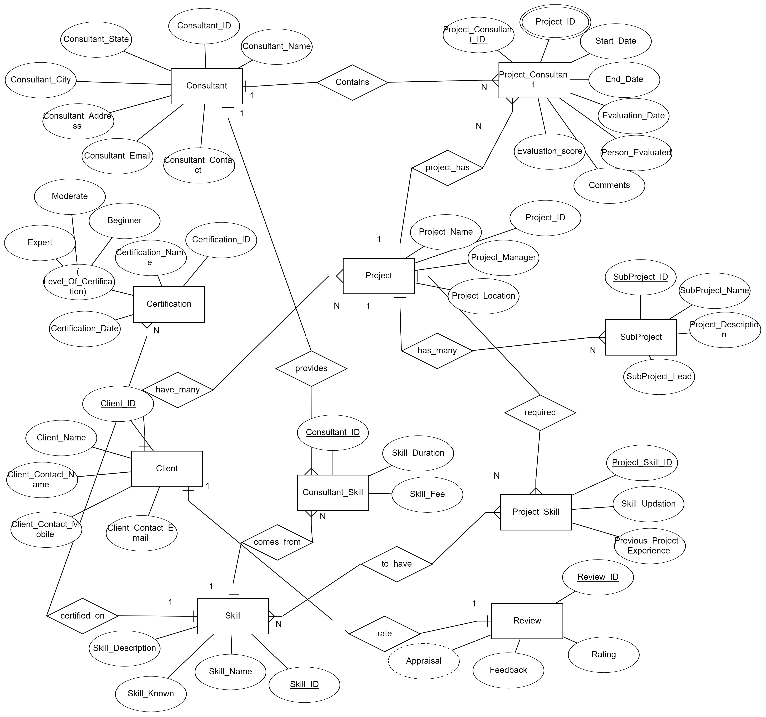
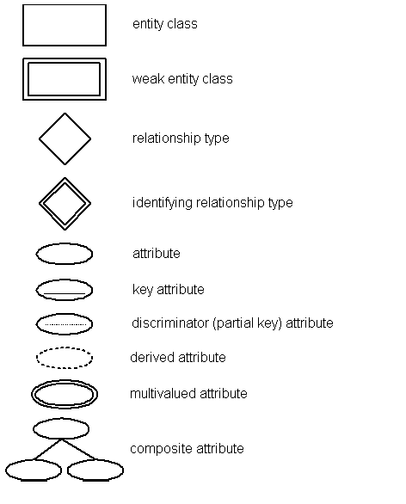
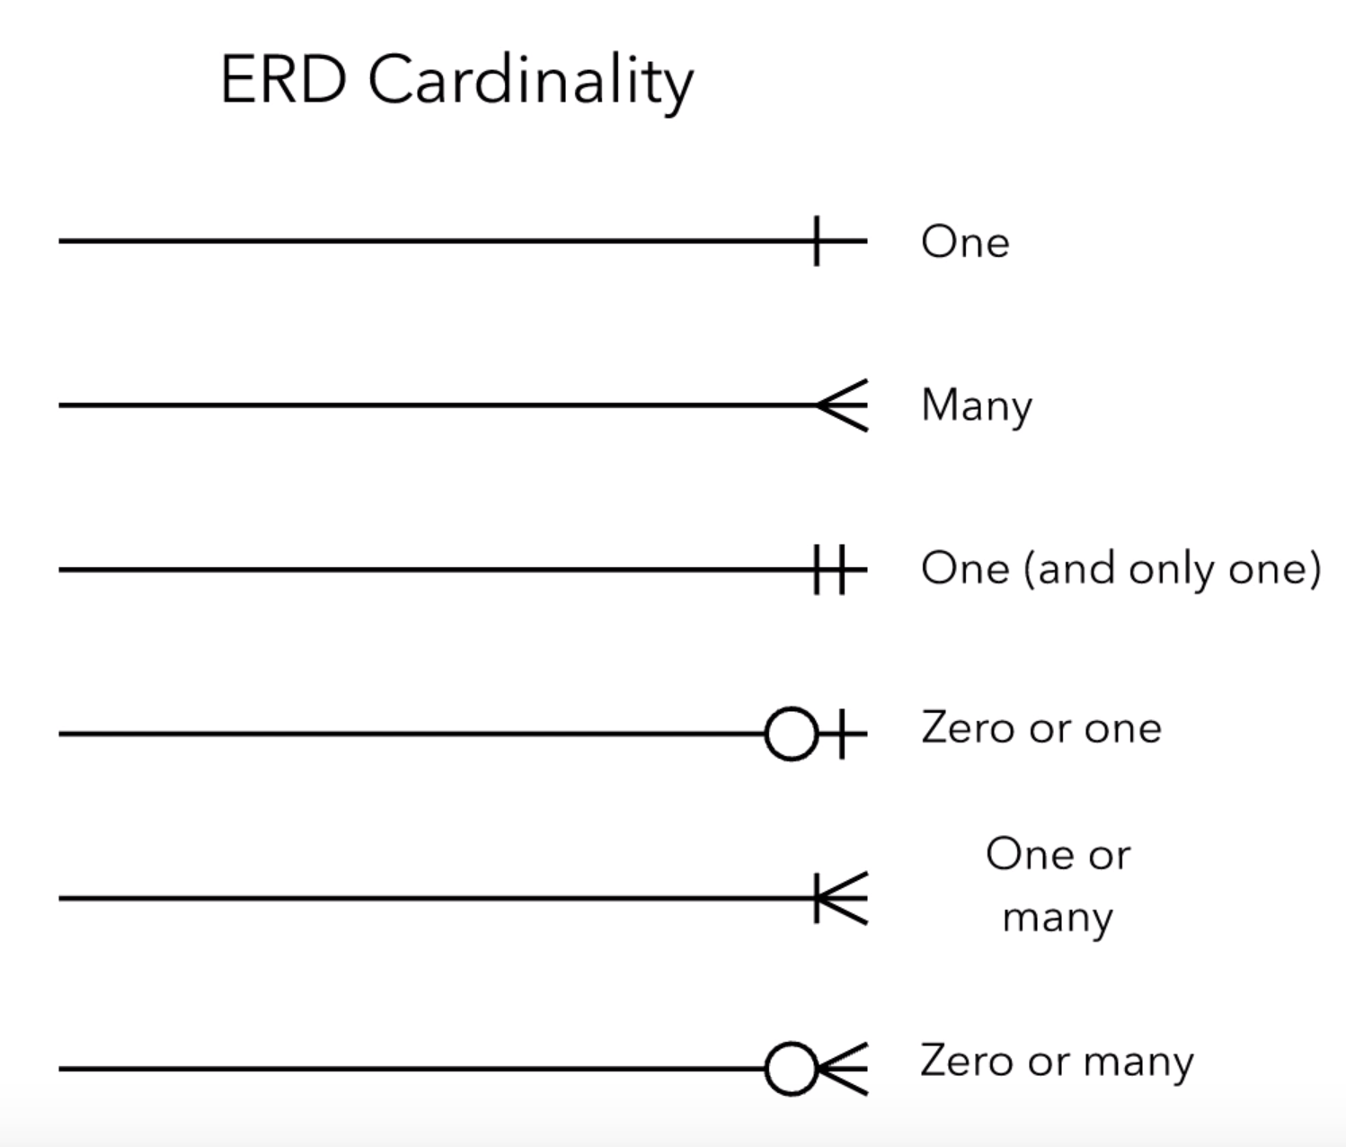
ENTITIY RELATIONSHIP MODEL [ ER- MODEL ]:
An Entity Relationship model (ER model) is design or a blueprint of a database. It illustrates how entities relate to each other within the system.
Entities Of Consultancy Management System [CMS]:
Consultant
Project_Consultant
Certification
Project
SubProject
Client
Skill
Consultant_Skill
Project_Skill
Review

Slide 7
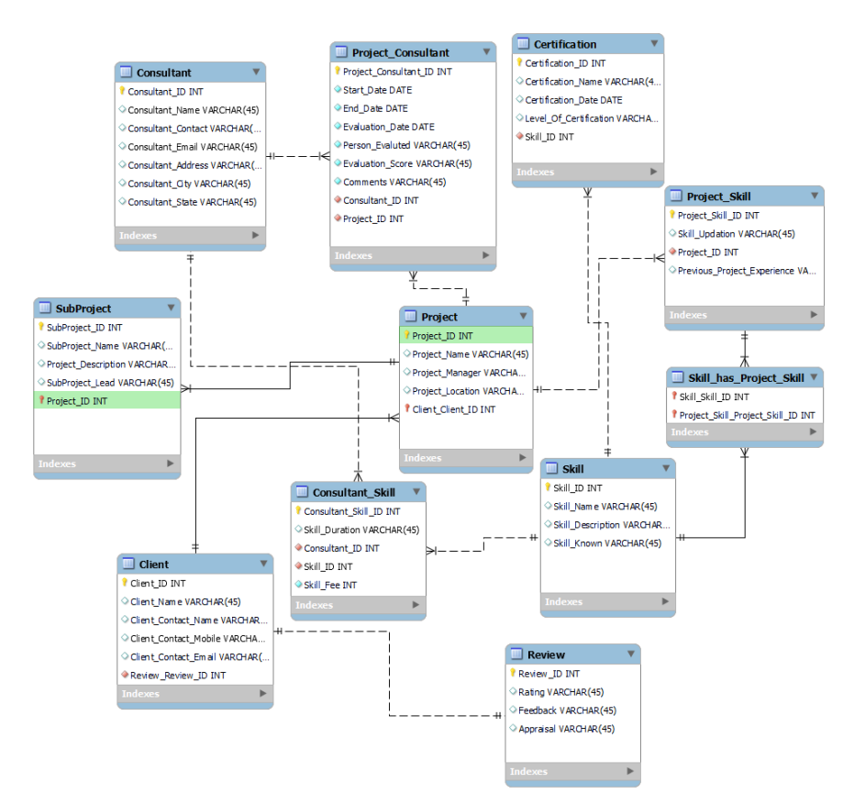
ENHANCED ENTITIY RELATIONSHIP MODEL
[ EER- MODEL ]:
Enhanced ER models are helpful tools for designing databases with high-level models. This ER model represents the database that we use for the project. The tables represent the schema. Each rectangle in the table describes the attributes and constraints of that table in the schema. Connecting lines between the tables define the relationship with other table, each relation has a constraint that connect one with the other

Slide 8
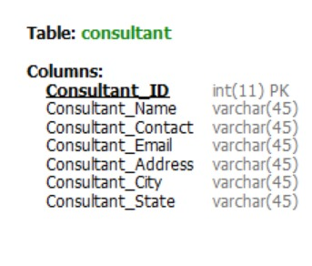
SQL DATABASE DEVELOPMENT
Consultant table below created by using CREATE from MySQL workbench.
The Consultant table contains following attributes with the respective datatypes.

Slide 9
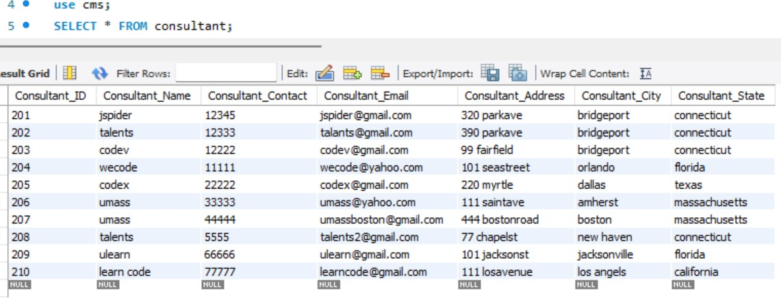
SQL DATABASE DEVELOPMENT
The below Consultant table is created by using MYSQL query. Here, data is retrieved from Consultant table using SELECT command.

Slide 10
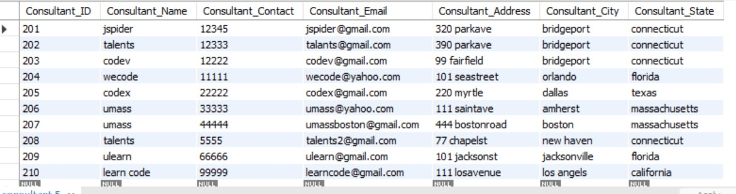
SQL DATABASE DEVELOPMENT
UPDATE command is used to edit the records of a table. It may be used to update single row or multiple rows using WHERE condition.

Slide 11
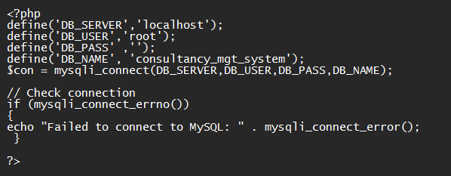
LOADING DATA & PERFORMANCE ENHANCEMENT
Connecting to the server requires to enter valid credentials i.e., DB_SERVER, DB_USER, DB_PASS, DB_NAME.
By providing valid credentials, phpMyAdmin connects to DB with the GUI (Graphical User Interface)
The following code connects MySQL database server of Consultancy Management System:

Slide 12
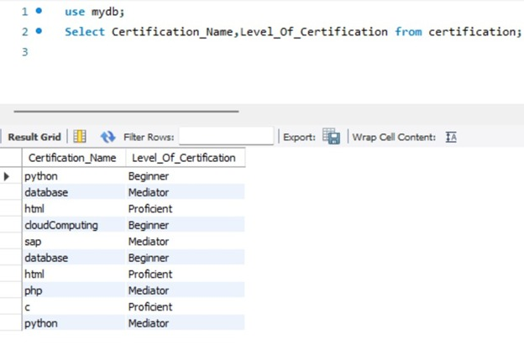
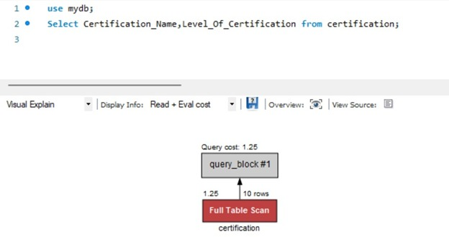
LOADING DATA & PERFORMANCE ENHANCEMENT
Select query is used to retrieve all data or specific data from a table. Select Certification_Name, Level_Of_Certification on certification table, displays all the data from Certification table.
Fig: Query optimization on Certification Table

Slide 13
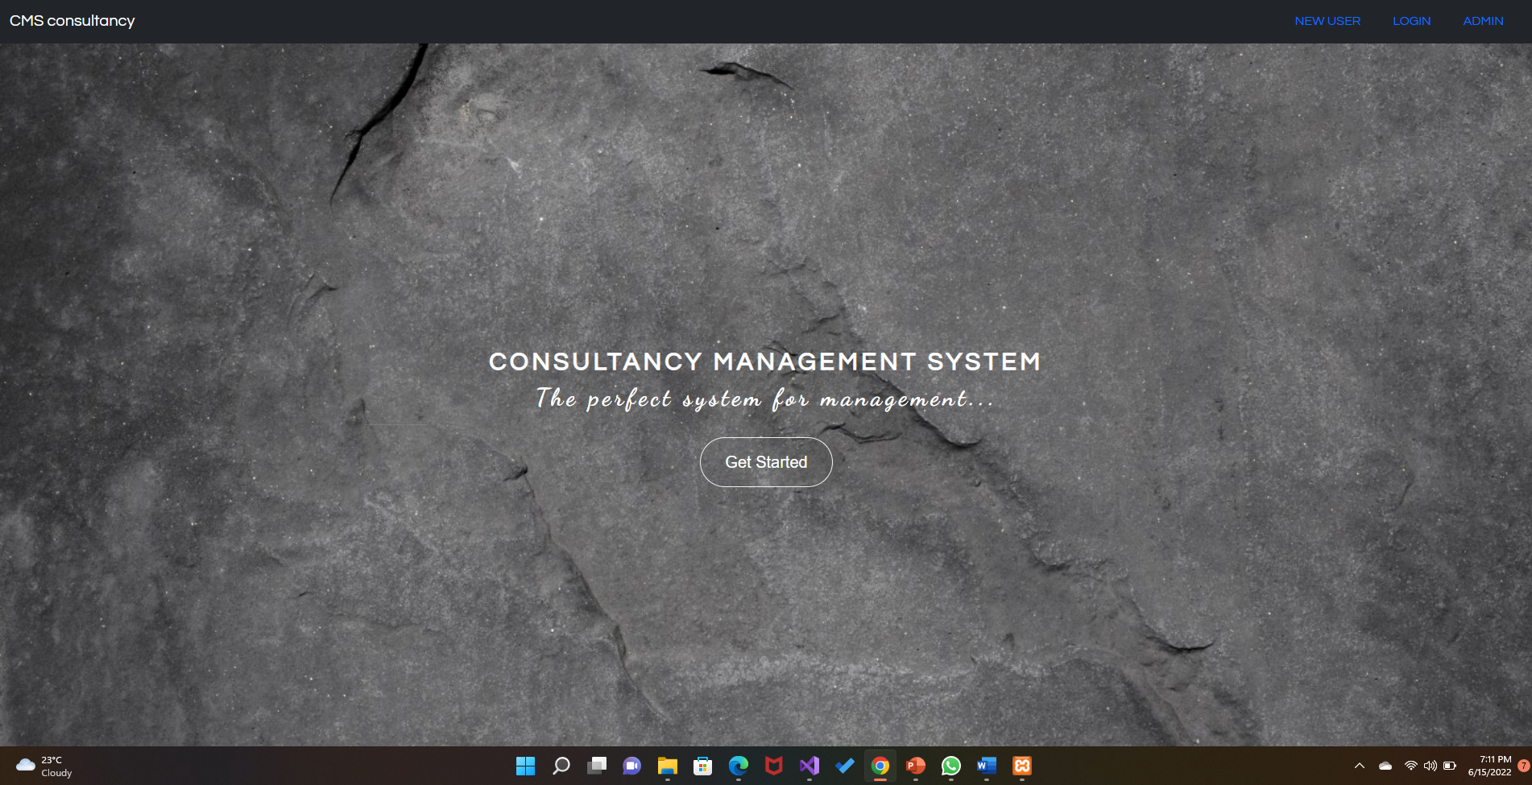
GRAPHICAL USER INTERFACE
Home page consists of Registration for new users, Admin login and User login.
This allows user and admin to access their respective panel by entering valid credentials.

Slide 14
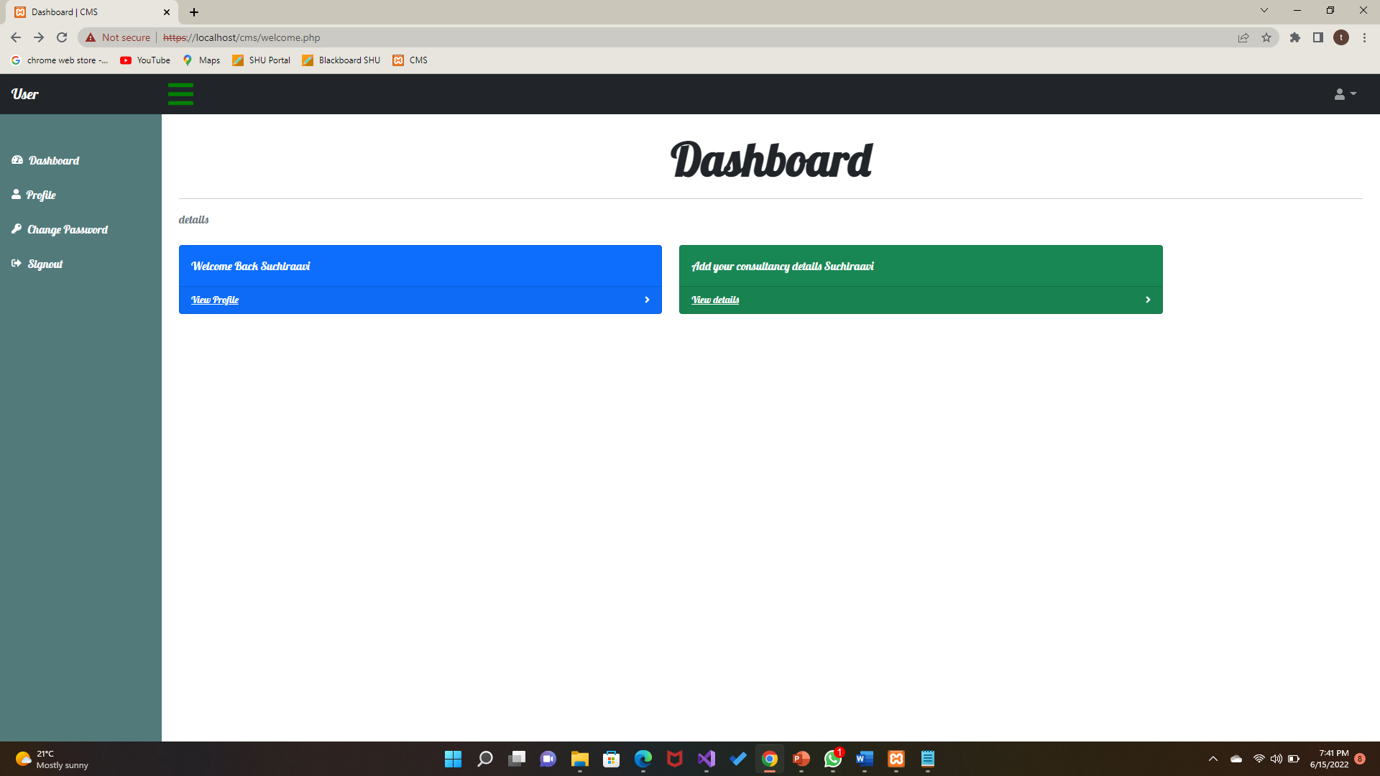
GRAPHICAL USER INTERFACE
User can access their dashboard after entering their credentials

Slide 15
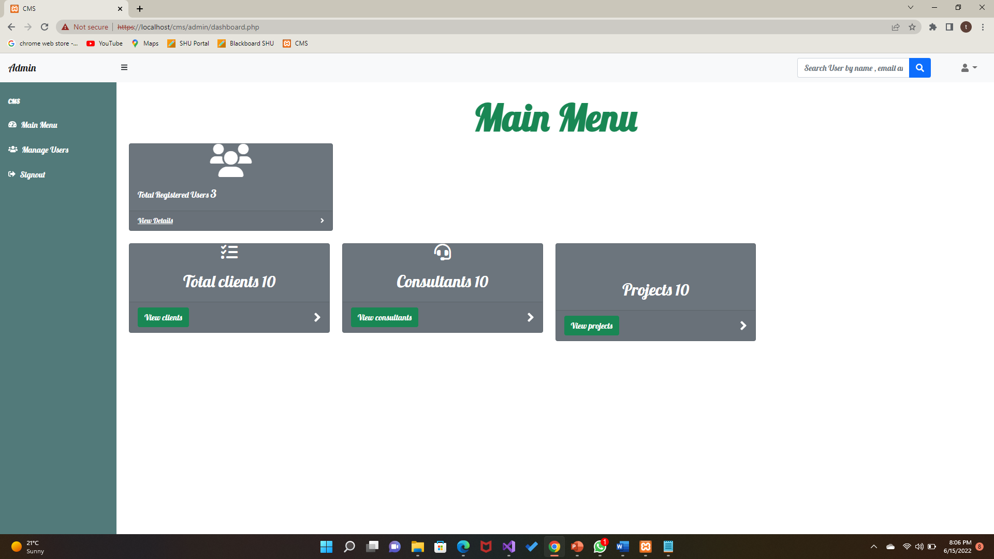
GRAPHICAL USER INTERFACE
Admin can access to :
The total no of user registered
Total no of clients
Total no of consultants
And the No of projects they had to deal with.
All the operations for the user and for the consultants are carried out by the admin.

Slide 16
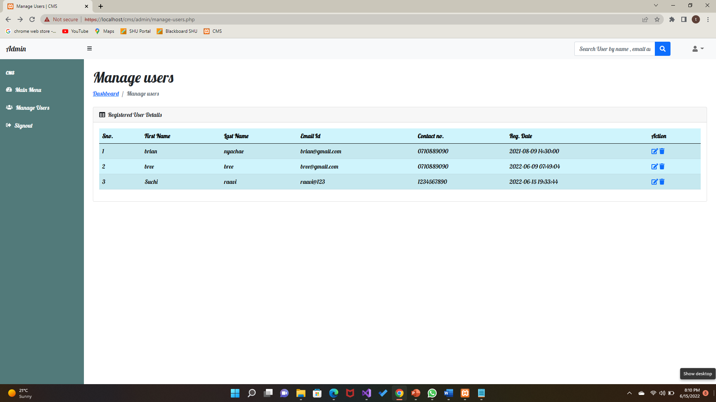
GRAPHICAL USER INTERFACE
Admin can perform operations like Select, Update & Delete by using search & edit options in Manage users tab.

Slide 17
References:
[1] https://studentprojectguide.com/vb-net/job-consultancy-management-system/
[2] https://erdplus.com/edit-diagram/41e53d32-f35f-48dc-8238-d7189f1851f9
[3] https://www.w3schools.com/sql/sql_join.as
[4] https://www.knowledgehut.com/blog/programming/web-development-using-php-mysql

Slide 18
Any Queries
?

Slide 19




Thank you !

